Slide 1








Build a Similar Images Finder ML Project
Supervision by: Mr. Ankur Chaturvedi
Team Members :
SUMIT KUMAR
RAHUL PATHAK
RAGHAV MITTAL

Slide 2




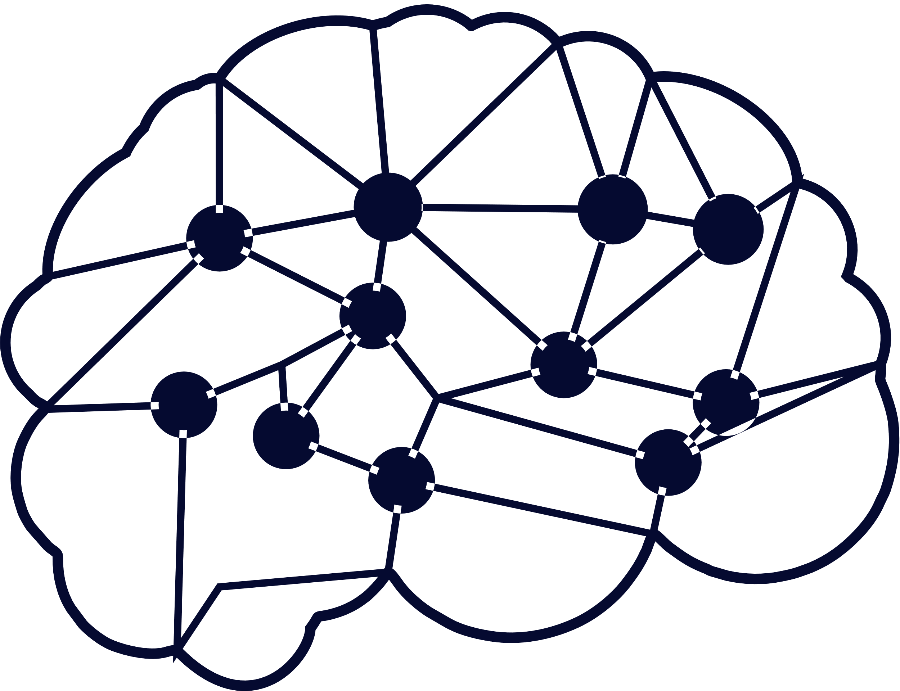

Index of Presentation
01
Introduction
04
Proposed Methodology
02
Literature Reviews
05
Results & Experiments
03
Research Gap Motivation
06
Conclusion & Future Work
07
References

Slide 3





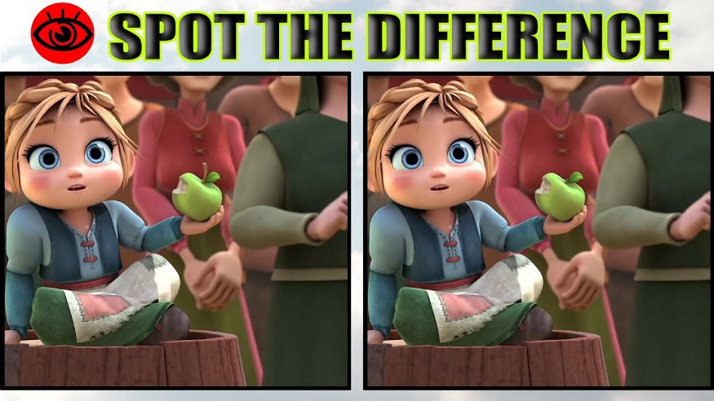


Introduction
Business Problem:
Have you ever played this game in your childhood where they will give two images and ask us to spot differences between them? Our problem statement is sort of similar to this where we need to find top N similar images given on a query image from a given dataset. Something like this…

Slide 4
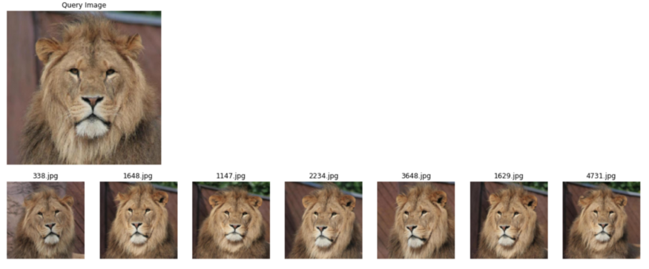
Introduction
Continue...
What is Image search?
A similar Image search is a kind of search in which we upload or give an image from a dataset and it will output top N similar images from that dataset.

Slide 5







Uses or Applications of Topic in Real Life Scenario
To discover people, places, and products.
To find similar images
Finding Plagiarized Photos
Detecting Fake accounts

Slide 6
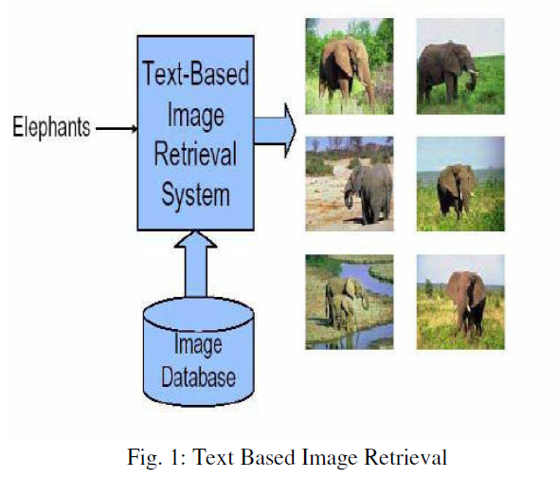
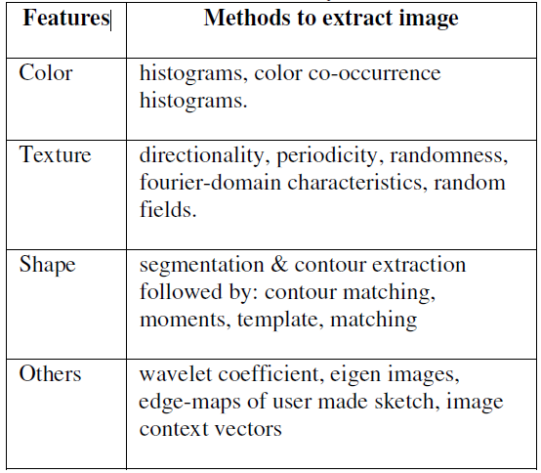
What Others have done in this area
Literature Reviews
Image Retrieval: A Literature Review
June 2012
Citation Number : 12
DOI:10.13140/2.1.1051.4565r
Data Set Used : Results Parameters with Accuracy :
Data collection Using the Internet spider program that can
collect webs automatically to interview Internet and do the
collection of the images on the web site, then it will go over
all the other webs through the URL, repeating this process
and collecting all the images it has reviewed into the server
Proposed Methods :
Future Work :
PERFORMANCE EVALUATION OF PROPOSED CBIR SYSTEM
Evaluation of retrieval performance is a crucial problem in
Content-Based Image Retrieval(CBIR). Many different
methods for measuring the performance of a system have
been created and used by researchers. With this, the
following formulae are used for finding Precision and Recall
values[13], [15].
Precision measures the proportion of the total images
retrieved which are relevant to the query.
1)Efficiency
Efficiently accessing stored images by content.
2) Storage
Providing compact storage for large image database.

Slide 7
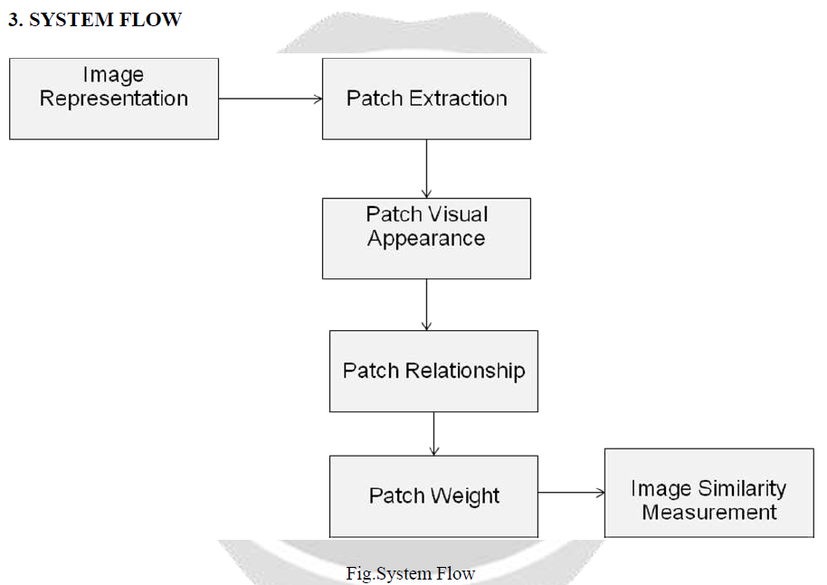
What Others have done in this area
Literature Reviews
A Survey on Finding Image Similarity and Retrieval of Near Duplicate Images
Vol-3 Issue-1 2017
Citation Number : IJARIIE-ISSN(O)-2395-4396
Data Set Used : Results Parameters with Accuracy :
Images data sets named :
Proposed Methods :
Future Work :
Esri Data Set
B. Euw2 Data Set
C. PRI Data Set
The performance of the face matching system can be calculated using verification time and accuracy.
A. Verification Time
Verification time is the period of time that a system takes to make decision.
B. Matching Accuracy
Matching accuracy is defined as below:
Matching Number of correct matches ×100
Accuracy = Total Number of testing images
To calculate the similarity between two images earth mover’s distance is used. Also the
Clustering process is used find out similarities

Slide 8
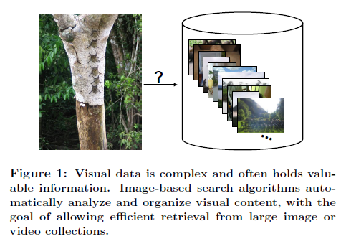
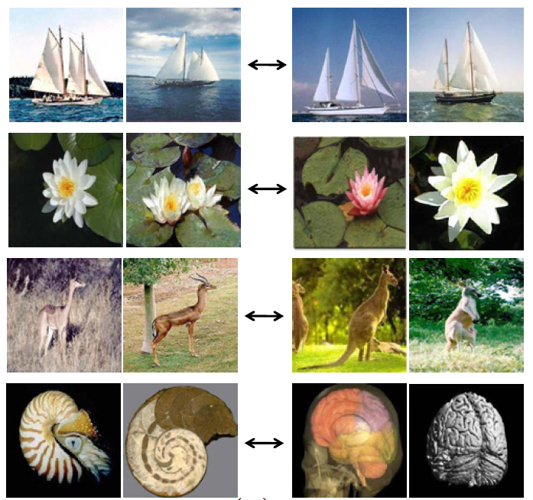
What Others have done in this area
Literature Reviews
Efficiently Searching for Similar Images
Year : 2009
Citation Number : grauman@cs.utexas.edu
Data Set Used :
Image data set
Proposed Methods :
Local Image Representations
Results Parameters with Accuracy :
LEARNING IMAGE METRICS
Future Work :
As the world’s store of digital images continues to grow exponentially,
and as novel data-rich approaches to computer
vision begin to emerge, fast techniques capable of accurately
searching very large image collections are critical

Slide 9
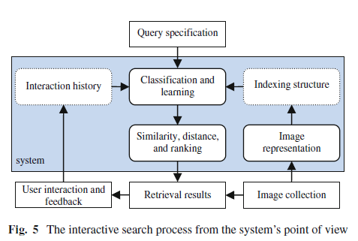
What Others have done in this area
Literature Reviews
Interactive search in image retrieval: a survey
Year : 2012
DOI 10.1007/s13735-012-0014-4
Data Set Used :
Internet Images
Proposed Methods :
Results Parameters with Accuracy :
A notable measure is generalized efficiency
which normalizes the performance of a feedback
method using the optimal classifier performance
Future Work :
Our current systems usually seek to minimize the number
of user labeled examples or the search time on the
assumption that it will improve the user satisfaction or
experience.

Slide 10
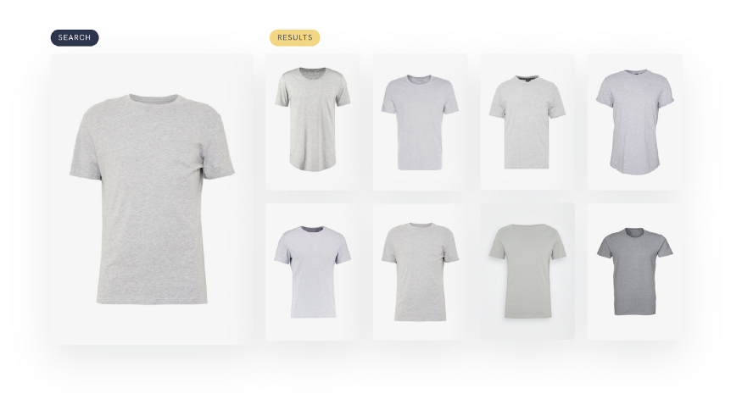
What Others have done in this area
Literature Reviews
Implement Image Similarity Using Deep Learning
Year : 2018
Citation Number
Data Set Used : Set of Images
Proposed Methods :
measure Image Similarity , euclidean distance, cosine similarity
Results Parameters with Accuracy :
The smaller the value more similar the images.
Future Work :
The approaches covered in this article can be easily applied to other Machine Learning areas like text, video, audio, or even tabular data. Every model that outputs a feature vector is suitable.

Slide 11




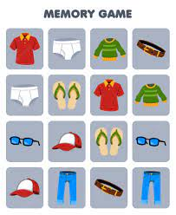


Motivation
To optimize the Space(ROM-memory) by removing duplicate images.
Memory Game
Image Search

Slide 12


Proposed Methodology
Importing the required classes from Deep Image Search
Load the Images from the Folder (single or multiple)
Indexing Data
List down the similar images
Directly Plot 16 similar images

Slide 13


Proposed Methodology Architecture
Features
Faster Search O(logN) Complexity.
High Accurate Output Result.
Best for Implementing on python based web application or APIs.
Applications are Images based E-commerce recommendation, Social media and other image-based platforms that want to implement image recommendation and search
Deep Image Search is an AI-based image search engine that includes deep transfer learning features Extraction and tree-based vectorized search technique.

Slide 14
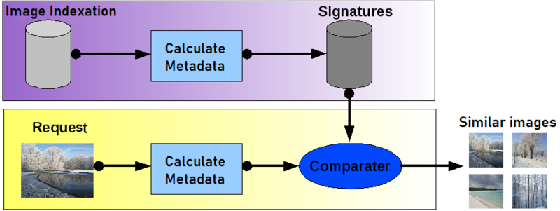
Proposed Methodology Architecture

Slide 15
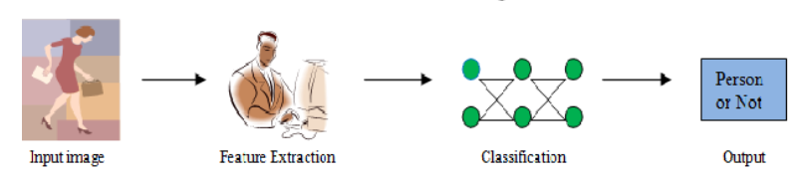

Proposed Methodology Architecture
Using deep learning for feature extraction
For a human, it's relatively easy to understand what's in an image—it's simple to find an object, like a car or a face; to classify a structure as damaged or undamaged; or to visually identify different land cover types. For machines, the task is much more difficult. However, it's critical to be able to use and automate machine-based feature extraction to solve real-world problems. To accomplish this, implement deep learning technology to detect and classify objects in imagery.
Deep learning is a type of machine learning that can be used to detect features in imagery. It uses a neural network—a computer system designed to work like a human brain—with multiple layers; each layer can extract one or more unique features in the image. Processing is often distributed to perform analysis in a timely manner.
Deep learning workflows for feature extraction can be performed directly.
To extract features from single images, imagery collections.

Slide 16
Discussion on Proposed Methodology
1. Importing the Important Classes
2. Loading the Images Data
There are three important classes you need to load LoadData - for data loading, Index - for indexing the images to database/folder, SearchImage - For searching and Plotting the images
For loading the images data we need to use the LoadData object, from there we can import images from the CSV file and Single/Multiple Folders
4. Searching
3. Indexing and Saving The File in Local Folder
Searching operation is performed by the following method:
# for searching, you need to give the image path and the number of the similar image you want
For faster retrieval we are using tree-based indexing techniques for Images features, So for that, we need to store meta-information on the local path [meta-data-files/] folder
you can also plot some similar images for viewing purpose by following the code method:
# If you want to plot similar images you can use this method, It will plot 16 most similar images from the data index

Slide 17
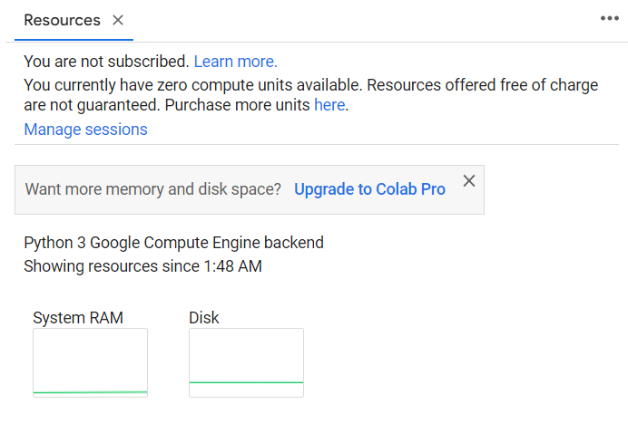
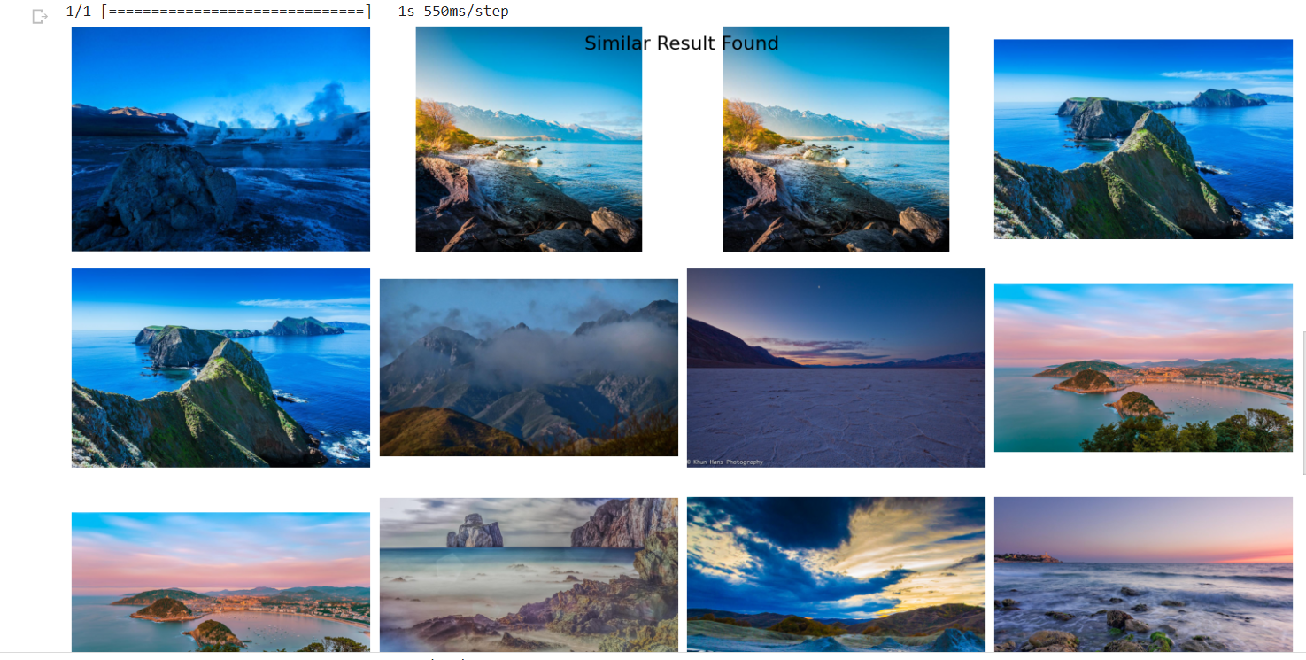
Experiments and Results
Data Set is taken from Kaggle ( Landscape Pictures )
System Description
the results are :

Slide 18




Conclusion and Future Work
Future Work
What next?
The approaches covered in this article can be easily applied to other Machine Learning areas like text, video, audio, or even tabular data. Every model that outputs a feature vector is suitable.

Slide 19
References
[1] B. Wang, Z. Li, M. Li, and W.-Y. Ma, “Large-scale duplicate detection for web image search,” in Proc. IEEE
Int. Conf. Multimedia Expo, Jul. 2006, pp. 353–356.
[2] Y. Ke, R. Sukthankar, and L. Huston, “Efficient near-duplicate detection and sub-image retrieval,” in Proc.
ACM Int. Conf. Multimedia, 2004, pp. 869–876.
[3] O. Chum, J. Philbin, and A. Zisserman, “Near duplicate image detection: Min-hash and tf-idf weighting,” in
Proc. Brit. Mach. Vis. Conf., 2008, pp. 493–502.
[4] S. Todorovic and N. Ahuja, “Region-based hierarchical image matching,” Int. J. Compute. Vis., vol. 78, no. 1,
pp. 47–66, 2008.
[5] G. Meng, N. Zheng, Y. Zhang, and Y. Song, “Document images retrieval based on multiple features
Combination,” in Proc. 9th Int. Conf. Document Anal. Recognit., Sep. 2007, pp. 143–147.
[6] S. Aksoy and R. M. Haralick, “Probabilistic vs. geometric similarity measures for image retrieval,” in Proc.
IEEE Int. Conf. Compute. Vis. Pattern Recognition., Jun. 2000, pp. 357–362.
https://www.researchgate.net/publication/264276256

Slide 20



Any Queries

Slide 21
Thank You

